Slide 1
Unit 6 Top down backtrack parsing

Slide 2
Problem of parsing
Given a Context Free Grammar G and a string w.
is w generated by G?
Most parsing methods fall into one of two classes: top down and bottom up, depend on the order in which nodes in the parse tree are constructed

Slide 3
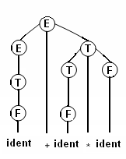
W has been parsed ⇒parse tree is constructed
E -> E + T
E -> T
T -> T * F
T -> F
F -> ( E )
F -> ident
How to express parse trees ?

Slide 4
Left parse
Left parse of α is the sequence of productions used in left derivation of α from S
Left parse is a string with numbers from 1 to p

Slide 5
Example
Consider grammar G, with productions are numbered
E → T+E
E → T
T → F* T
T → F
F → (E)
F → a
Left parse of string a*(a+a) is 23645146246

Slide 6
Top down backtrack parsing algorithm
Input: Grammar G, string w
Output one left parse for w if one exists. The output “error” otherwise
For each nonterminal A , order the alternate for A : A → α1 | α2 | . . . .| αn

Slide 7
Description of algorithm
Begin with a tree containing one node labeled S
S is considered active node
Other nodes are generated recursively

Slide 8
Active node is label by nonterminal A
Choose the first alternate of A: X₁X₂. . . .X_{k}.
Create k direct descendants for A labeled X₁, X₂, . . . .X_{k}.
Make X₁ the active node
If k = 0, (production A → ε) make the node immediately to the right pf A active

Slide 9
Active node is labeled by a terminal a
Compare the current input symbol with a.
If they match, make the active node immediately to the right of a, move the input pointer one symbol to the right.
If they do not match, go back to the node where the previous production was applied.
Adjust the input pointer if necessary, and try the next alternate. If no alternate is possible, go back to the next previous node, and so forth.
If the current node is the root and no alternate is possible, emit an error message.

Slide 10
A stringent condition
Grammar G must be non left recursive to avoid a non-termination

Slide 11
Example
Given grammar
S → aSb | c
productions are numbered from 1 to 2.
And string w= aacbb

Slide 12
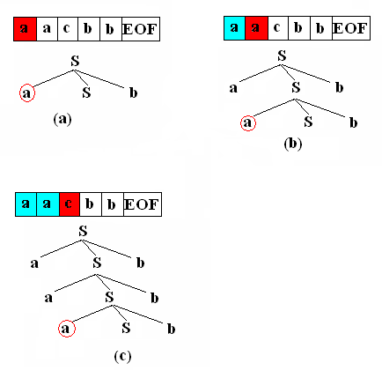
Build parse tree

Slide 13
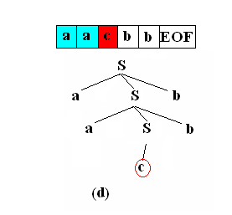
Try another alternate

Slide 14
The top down parsing algorithm
Input
A non-left recursive context free grammar G,
Input string w = a1. . . .an, n ≥ 0
Assume the productions in P are numbered 1,. . . q
Output
One left parse for w if one exist.
“Error” otherwise.

Slide 15
Method
(The algorithm uses 2 stacks D1 and D2).
D2 represents the current left sentential form, which our expansion of nonterminals has produced.
D1 represents the current history of the choices of alternates made and the input symbols over which the input head has shifted.

Slide 16
(1)
∀ A ∈ N , if all af A-productions in P are
A → α1 | α2 | . . . .| αn
Order the alternates
A1 → α1
. . . .
An → αn

Slide 17
Configuration of the algorithm
4-tuple (s, i, α, β)
s ∈ Q: the current state
q: normal operation
b: backtracking
t: terminating
i : location of the input pointer (the n+1 st “input symbol” is #, the right endmarker)
α: content of the first stack (D1)
β: content of the second stack (D2)

Slide 18
Execution of the algorithm
Starting in the initial configuration, compute successive next configurations until no further configuration can be computed.
If the last computed configuration is (t,n+1,γ,ε), emit h(γ) and halt. Otherwise emit the error signal.

Slide 19
Example
Consider string aacbb and grammar G
S → aSb
S → c

Slide 20
Number productions
S1 → aSb
S2 → c

Slide 21
Sequence of configurations
(q,1, ε, S#)
|⎯ (q, 1, S₁, aSb#)
|⎯ (q, 2, S1a, Sb#)
|⎯ (q, 2, S1aS1,aSbb#)
|⎯ (q, 3, S1aS1a, Sbb#)
|⎯ (q, 3, S1aS1aS1,aSbbb#)
|⎯ (b, 3, S1aS1aS1,aSbbb#)
|⎯ (q, 3, S1aS1aS2, cbb#)
|⎯ (q, 4, S1aS1aS2c,bb#)
|⎯ (q, 5, S1aS1aS2cb,b#)
|⎯ (q, 6, S1aS1aS2cbb,#)
|⎯ (t, 6, S1aS1aS2cbb, ε )

Slide 22
Recover the left parse
h(a) = ε for all terminal a
h(Ai)= p ,
p is the production number associated with the production A→ γ and γ is ith alternate for A
Example : with grammar
h(S1aS1aS2cbb)=112
S1 → aSb
S2 → c

Slide 23
Top-down parser with bactraking for KPL
Scan the stream and find tokens
Set of production

Slide 24
From syntax diagrams to BNF
<program >::= program ident ; <block>.
<block>::= <const-decl><type-decl>
<proc-decl><func-decl><var-decl> begin <statement-list> end

Slide 25
Non-terminal encoding
if (str == "<para-list>") return 13;
if (str == "<para-one>") return 14;
if(str=="<func-decl>") return 15;
if(str=="<statement-list>") return 16;
if(str=="<statement>" ) return 17;
if (str == "<condition>") return 18;
if (str == "<relation>") return 19;
if(str=="<expression>") return 20;
if (str == "<adding-op>") return 21;
if(str=="<term>") return 22
if(str=="<multiplying-op>") return 23;
if (str == "<factor>") return 24;
if(str=="<program>") return 1;
if(str=="<block>") return 2;
if(str=="<const-decl>") return 3;
if (str == "<const-assign-list>") return 4;
if (str == "<constant>") return 5;
if(str=="<type-decl>") return 6;
if (str =="<type-assign-list>") return 7;
if (str == "<type>") return 8;
if (str == "<basictype>") return 9;
if(str=="<var-decl>") return 10;
if (str == "<ident-list>") return 11;
if(str=="<proc-decl>") return 12;

Slide 26
Token encoding: identifiers, number, character constants, specific symbols
// ident;
if(str == "ident") return 25;
//const
if(str == "number")return 26;
if (str == "charcon") return 27;
//operator
if(str == "plus")return 28;
if (str == "minus") return 29;
if (str == "times") return 30;
if (str == "slash") return 31;
if (str == "assign") return 33;
if (str == "leq") return 34;
//specific symbol
if (str =="lparen") return 35;
if (str == "rparen") return 36;
if (str == "comma") return 37;
if (str == "semicolon") return 38;
if (str == "period") return 39;
if (str == "becomes") return 40;
if (str == "lbrace") return 41;
if (str == "rbrace") return 42;
if (str == "lbrack") return 43;
if (str == "rbrack") return 44;

Slide 27
Token encoding: keywords
if (str == "beginsym") return 45;
if (str == "endsym") return 46;
if (str == "ifsym") return 47;
if (str == "thensym") return 48;
if (str == "whilesym") return 49;
if (str == "dosym") return 50;
if (str == "callsym") return 51;
if (str == "constsym") return 52;
if (str == "varsym") return 53;
if (str == "progsym") return 54;
if (str == "funcsym") return 55;
if (str == "typesym") return 56;
if (str == "arraysym") return 57;
if (str == "ofsym") return 58;
if (str == "intsym") return 59;
if (str == "charsym") return 60;

Slide 28
Token encoding : relop
//relations
if (str == "eql") return 61;
if (str == "leq") return 62;
if (str == "neq") return 63;
if (str == "lss") return 64;
if (str == "gtr") return 65;
if (str == "geq") return 66;

Slide 29
Production encoding
<program >::= program ident ; <block>.
setlaw[1,1]="54 25 38 2 39 ";
<block>::= <const-decl><type-decl>
<proc-decl><func-decl><var-decl> begin <statement-list> end
setlaw[2,1]=" 3 6 12 15 10 45 16 46 ";

Slide 30
Conclude
Too complicated with backtracking.
Spent exponential amount of time.
Difficult to handle errors.

